Slide 1
Analyzing Lower Torso Curves for Computational Apparel Design and Modeling
Team Curve
Wenxuan Hong (wh459), ​
Aristotle Kolefas (aak99), ​
Diane Xu (sx265), ​
Zongjie Yin (zy347), ​
Fanjun Zeng (fz224) ​.
Advisors: Dr. Sreyoshi Das
Client: Dr. Fatma Baytar, Dr. Sumanta Basu.

Slide 2
Content
Background
Data Description
Analysis/Methodology
Conclusion & Limitations

Slide 3
Background

Slide 4
Background
Fashion system is flawed in terms of ready-to-wear clothing fit for women
Approximately 50% of women struggle to find well-fitting clothes
Dr. Baytar's friend in the apparel industry reports challenges with rise shapes, especially for non-flat/curvy body types
Why?
Crotch curve is often drawn haphazardly in pants pattern creation, causing fit problems

Slide 5
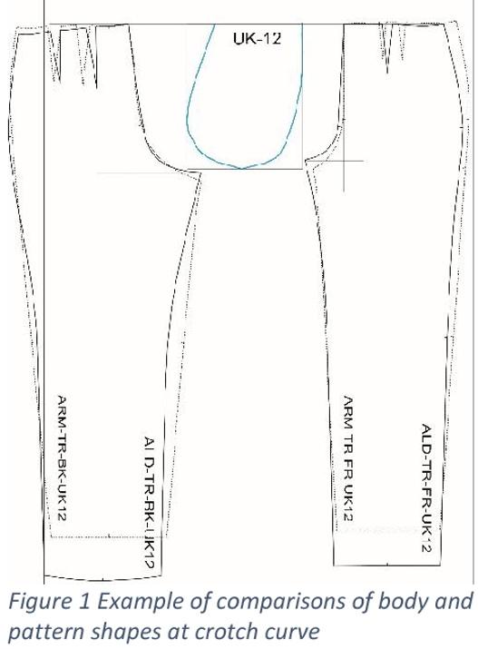
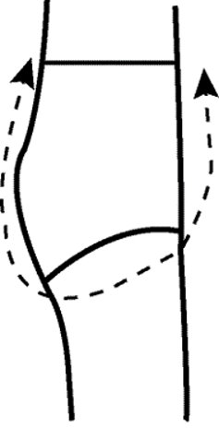

Slide 6
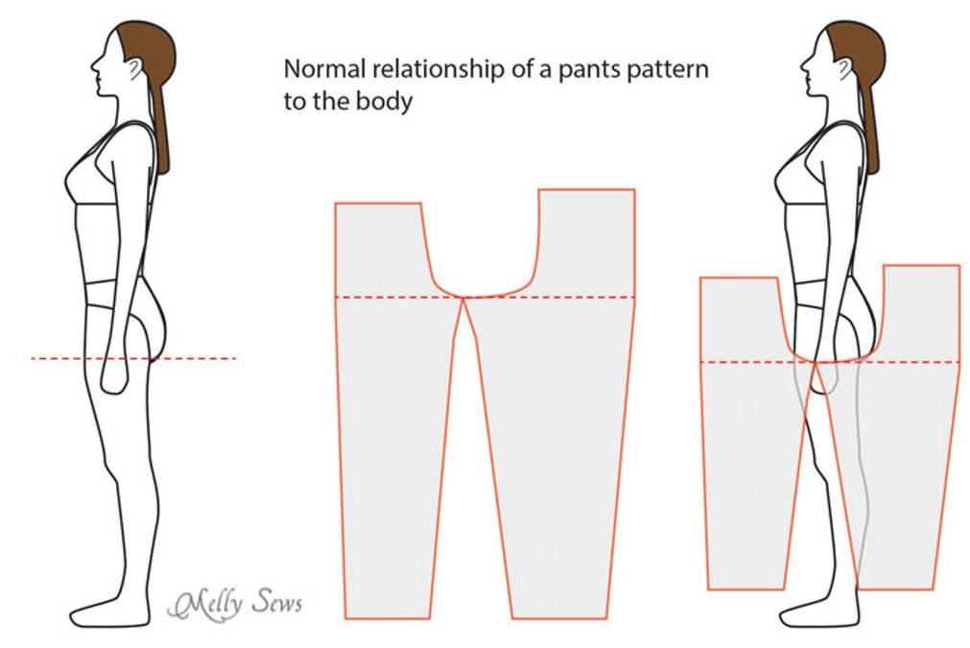

Slide 7
Findings from Scientific Literature
Manufacturers must measure torso curves + other anatomical features to create clothing that fits body
Researchers
Have developed techniques and methods that generate customized patterns for different body types and improve clothing fit and comfort
Generating crotch curves
Classifying women's waist-hip-leg position
Identifying lower body shapes
Creating 3D models of lower bodies
Developing pant alteration techniques
Are exploring the shape of the crotch curve, fabric, style, and technology to increase clothing comfort
Have developed/tested a computerized draping method for creating personalized patterns for skirts + pants
To-do: expand the scope of these techniques and methods to include other types of clothing or other demographic groups.

Slide 8
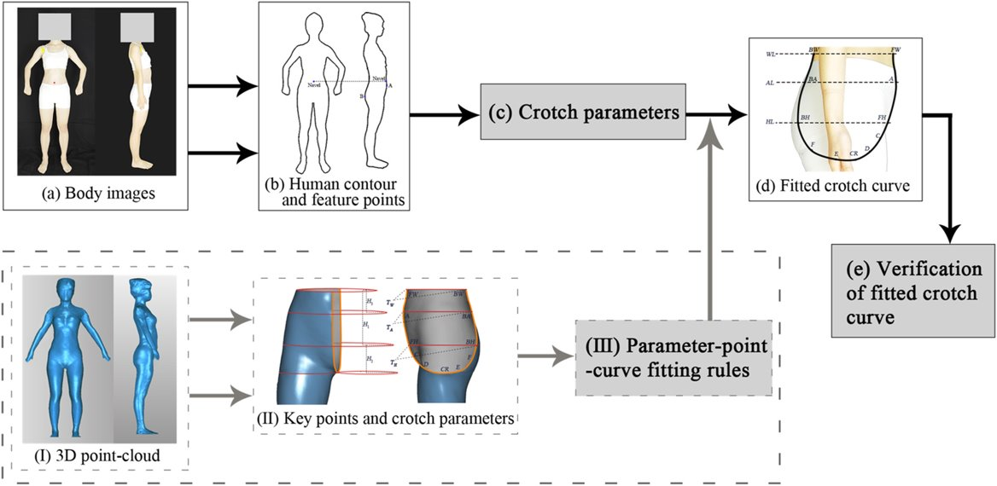

Slide 9
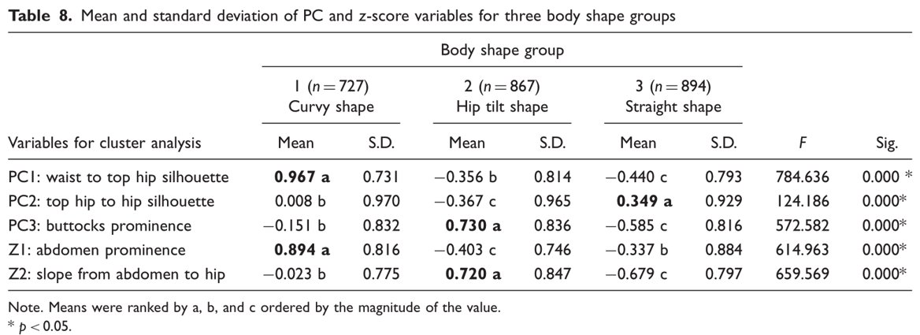
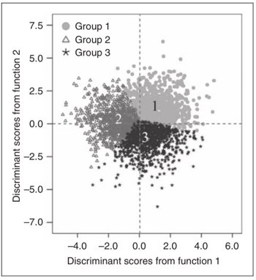
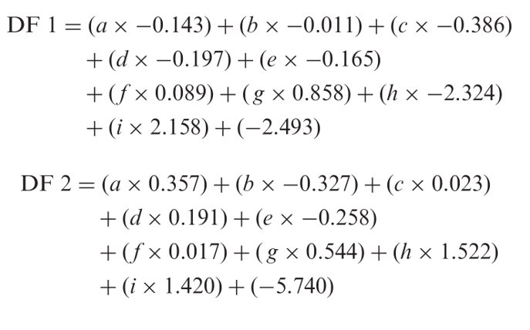
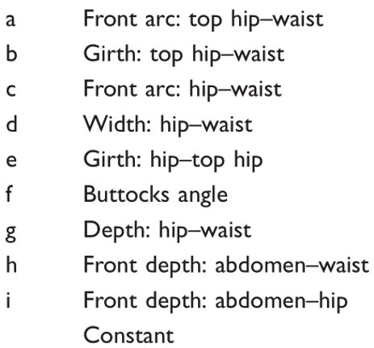

Slide 10
Data Description

Slide 11
Data Description
Column | Type | Description
Subject ID | Integer | Sample (Person) ID
Race | String | The race of the sample (Person)
BMI | Float | The BMI of the sample (Person), kg/m²
Height | Integer | The height of the sample (Person), mm
Maximum Hip | Integer | Measurement of the widest part of your bum, mm
Anterior posterior Length | Float | Distance taken along the crotch seam line from the center front waistline to the center back waistline, passing through the crotch point, mm
Depth | Float | Distance from waistline to crotch point, mm

Slide 12
Data Cleaning
Processing
Remove individuals with
at least one missing value
abnormal curve
Outcome
544 individuals remained
400 Whites
66 African Americans
57 Asian Americans
6 Hispanics
15 Other races

Slide 13
Summary Statistics – Main Findings
Af. Amers have highest mean BMI, hip circumference, and ant.-post. length
White individuals tend to be tallest, Asians shortest
Other races have largest depth, Asians have smallest
BMI and weight most variable in African Americans
Asians show least variability in both BMI and weight
Height most variable among Af. Amers and Others, most consistent among Asians
Maximum hip circumference has largest standard deviation among Af. Amers, smallest among Asians
Anterior-posterior length usually most variable among Af. Amers, least among Asians
Whites and those of "Other" race show most variation in depth

Slide 14
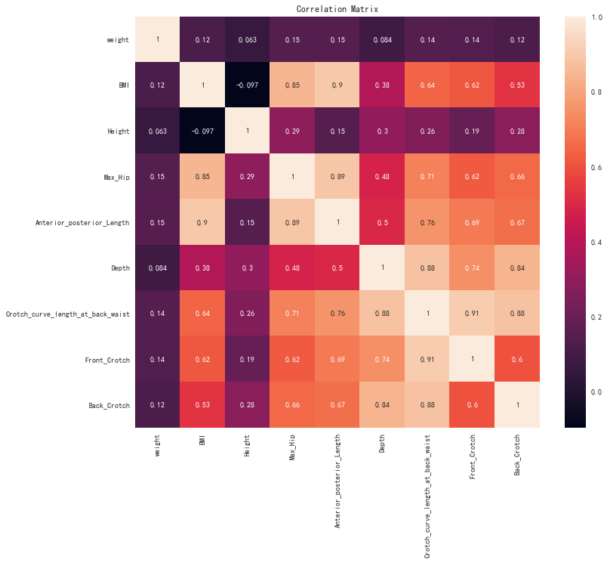
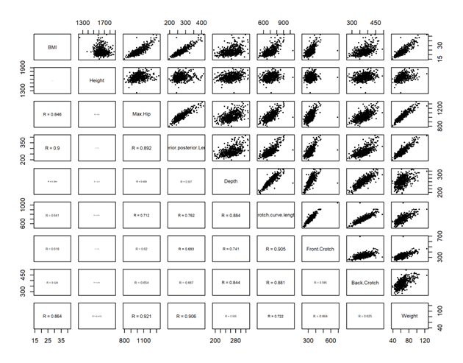
Correlation of Data

Slide 15
Linear Regression
Modeling
Ran three multiple linear regression models on the data in R
Features: race, height, weight, max hip circumference
Responses: crotch curve length at back waist, depth, anterior-posterior length length
For each model,
Created histograms and plots of the residuals vs. Index number
Produced Normal Q-Q, Scale Location, and Leverage plots
Residuals showed no discernible functional trend; distributed normally with linear Q-Q plots.
Findings
Most effective predictors
Crotch length at back waist: weight, max hip circumstance
Depth: race (White), weight, height
Anterior-posterior length: weight, height, max hip circumstance
Residuals are normally distributed

Slide 16
 | Estimate | Std. Error | T-value (Wald test) | P-value (two-sided)
Intercept | 313.42 | 68.62 | 4.57 | 0.00
Asian | 2.09 | 8.79 | 0.24 | 0.81
Hispanic | -2.96 | 19.78 | -0.15 | 0.88
Other | 12.60 | 13.21 | 0.95 | 0.34
White | 6.40 | 6.29 | 1.02 | 0.31
Height | -0.01 | 0.03 | -0.37 | 0.71
Weight | 2.60 | 0.47 | 5.52 | 0.00
Maximum hip circumference | 0.232 | 0.06 | 3.72 | 0.00
Regression of crotch curve length at back waist on race, height, weight, and maximum hip circumference (R² = 0.5373)

Slide 17
Analysis/Methodology

Slide 18
Questions to Explore
Do body shapes vary based on factors such as ethnicity, height, or BMI?
Is it possible to predict curve shapes based on measurements such as max hip and crotch depth?
Is there any distinct pattern that differentiates the races?
Is it possible to predict the race of the subject based on his/her body measurements and front and back curve coefficients?

Slide 19
Key Question: Do body shapes vary based on factors such as ethnicity, height, or BMI?

Slide 20
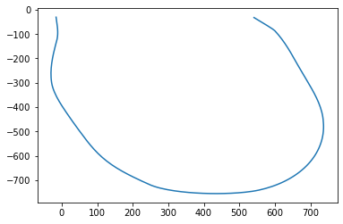
Key Question: Do body shapes vary based on factors such as ethnicity, height, or BMI?
Strategy:
Fit the curve with a model and extract model coefficients
Use model coefficients to characterize the corresponding curve
Analyze the variations of model coefficients based factors
Extracting Coordinates
Curve Fitting
Analysis
100 Curve Coordinates
4 Model Coefficients
Variations

Slide 21
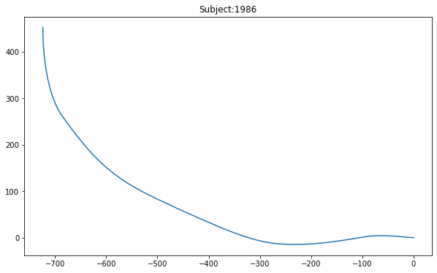
Key Question: Do body shapes vary based on factors such as ethnicity, height, or BMI?
Curve Fitting – Dividing Curves
Original Curve
Problem:
Crotch curve is not a function (fails vertical line test)
Solution:
Divide the curve at its deepest point
Rotate each piece by 90 degrees
Front Curve After Rotation

Slide 22
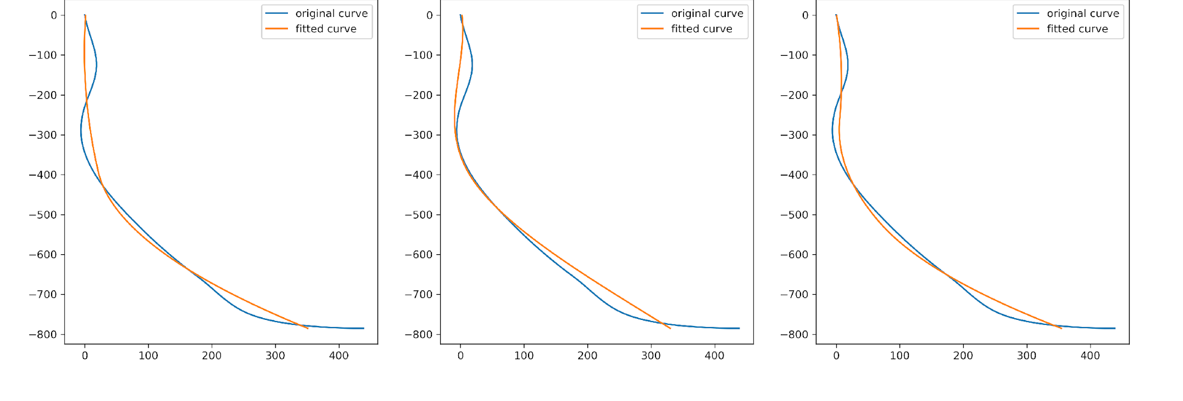
Key Question: Do body shapes vary based on factors such as ethnicity, height, or BMI?
Curve Fitting – Model Selection
Fitted Curve vs. Original Curve with different hyperparameters
Spline models can generate a fixed number of coefficients
Fit curves by spline models with different hyperparameters
Compared the fit of the curves to find the best model hyperparameters
Spline model with degree = 2 and knots = 3 is optimal (a high accuracy and a low model complexity)
4 coefficients for each curve
degree = 2
knots = 3
degree = 3
knots = 3
degree = 2
knots = 4
Median R-Squared Values of Fitted and Original Curves
Race | White | African American | Asian | Hispanic | Other
Median R-Squared | 0.992 | 0.991 | 0.992 | 0.991 | 0.992

Slide 23
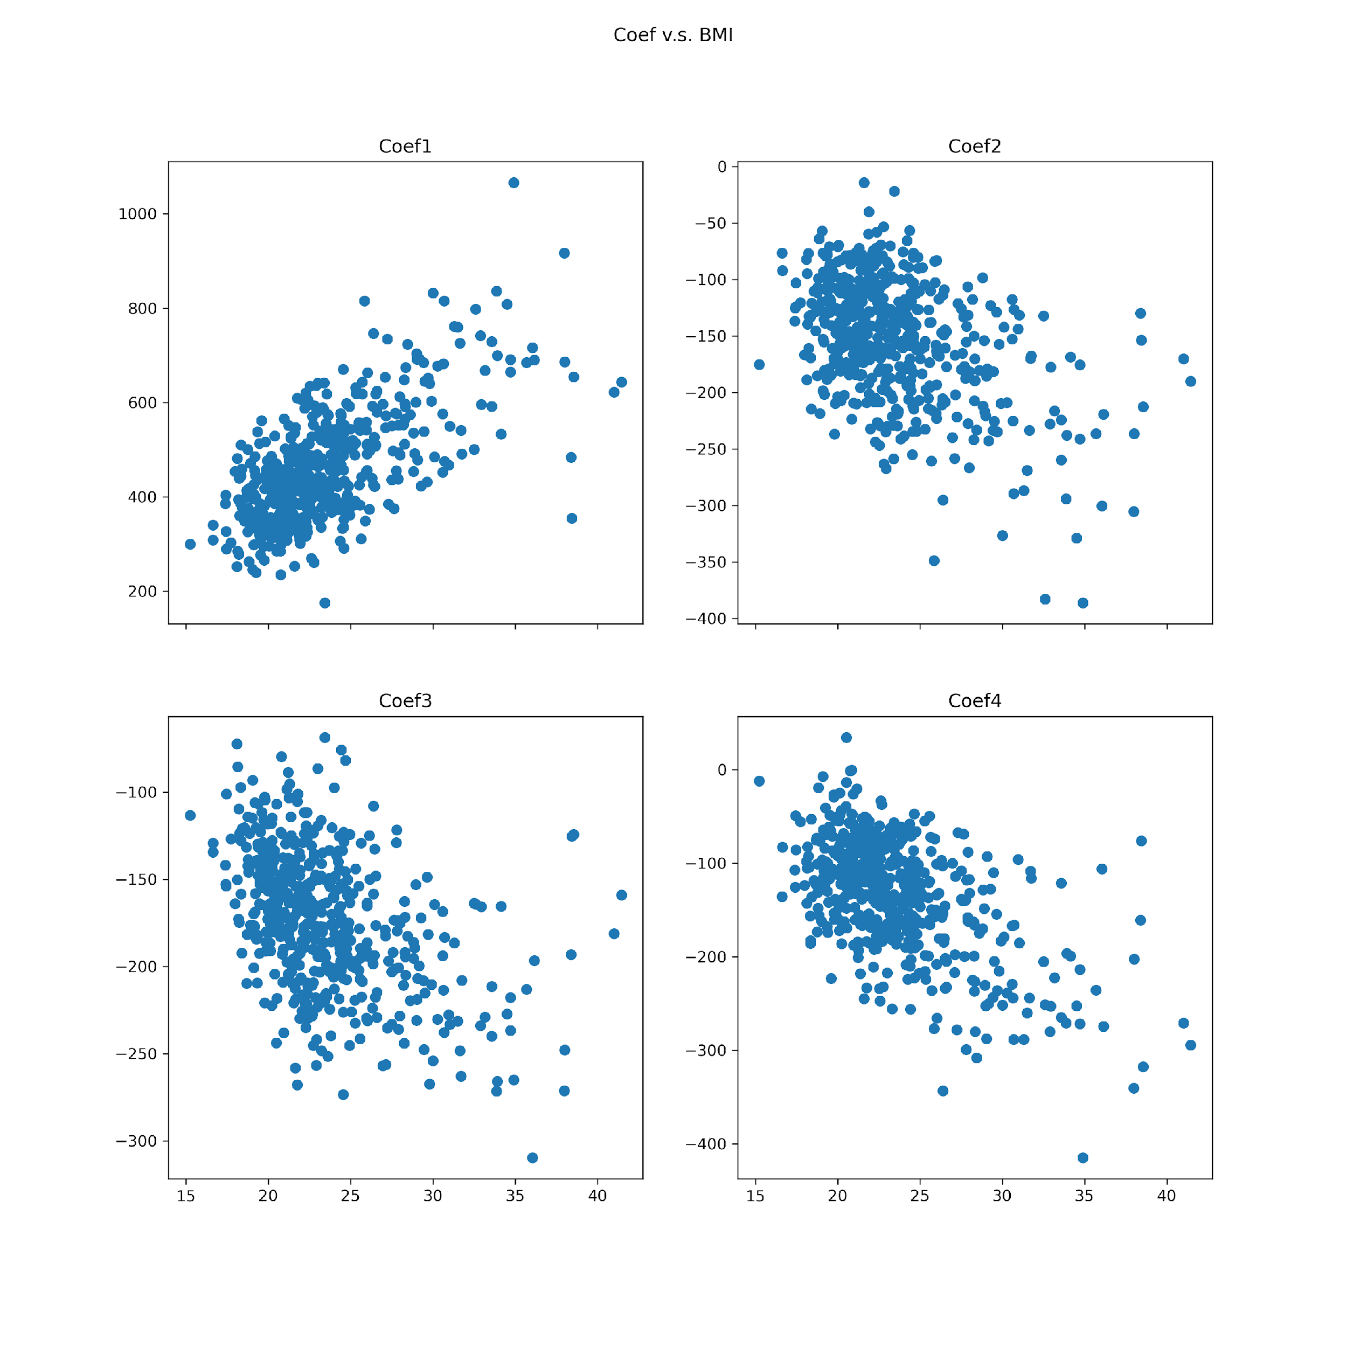
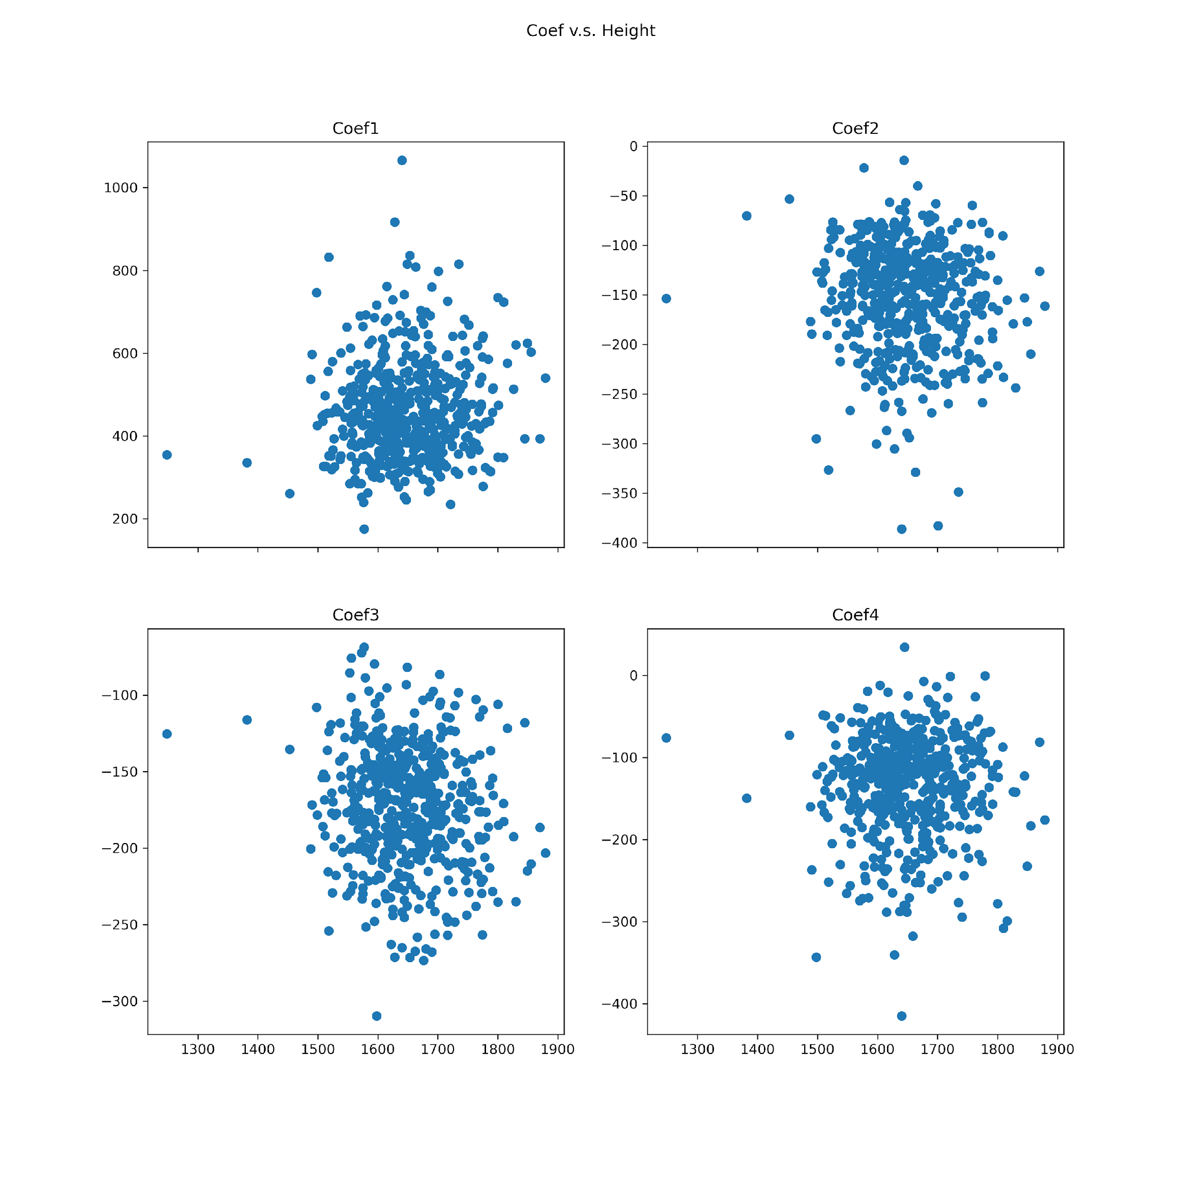
Key Question: Do body shapes vary based on factors such as ethnicity, height, or BMI?
Variations – Coefficients vs. BMI and Height
Coefficients vs. BMI
Coefficients vs. Height​

Slide 24
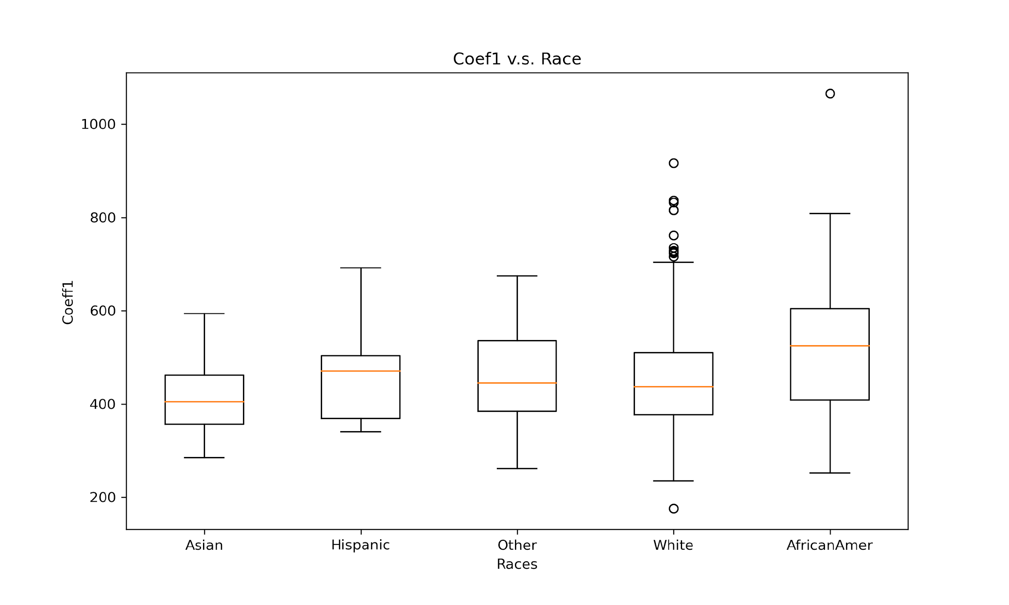
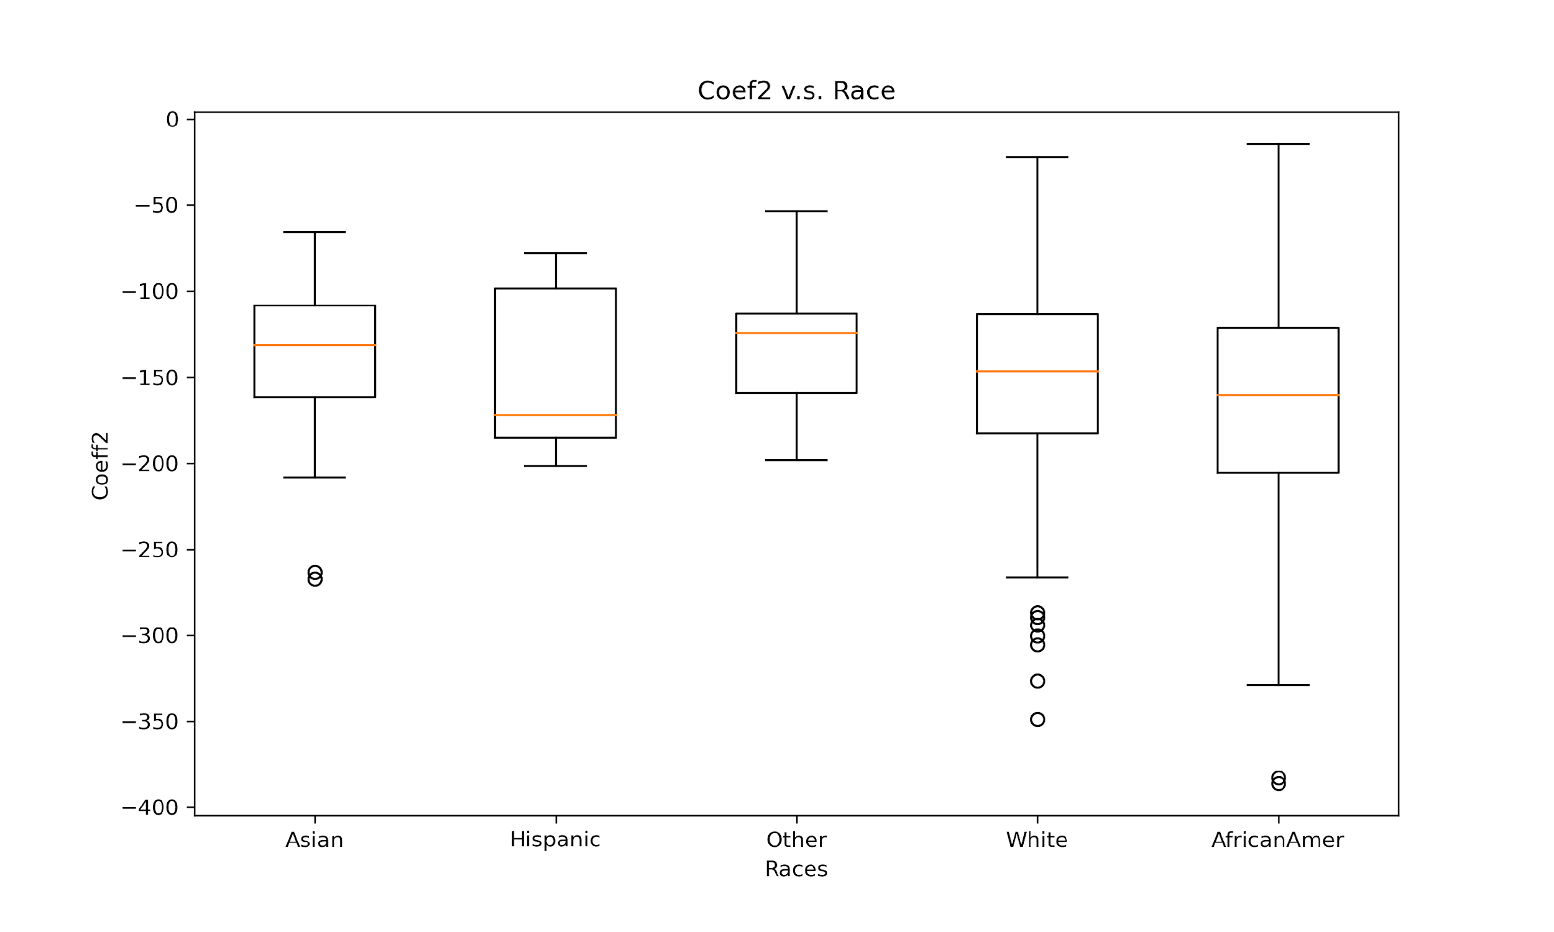
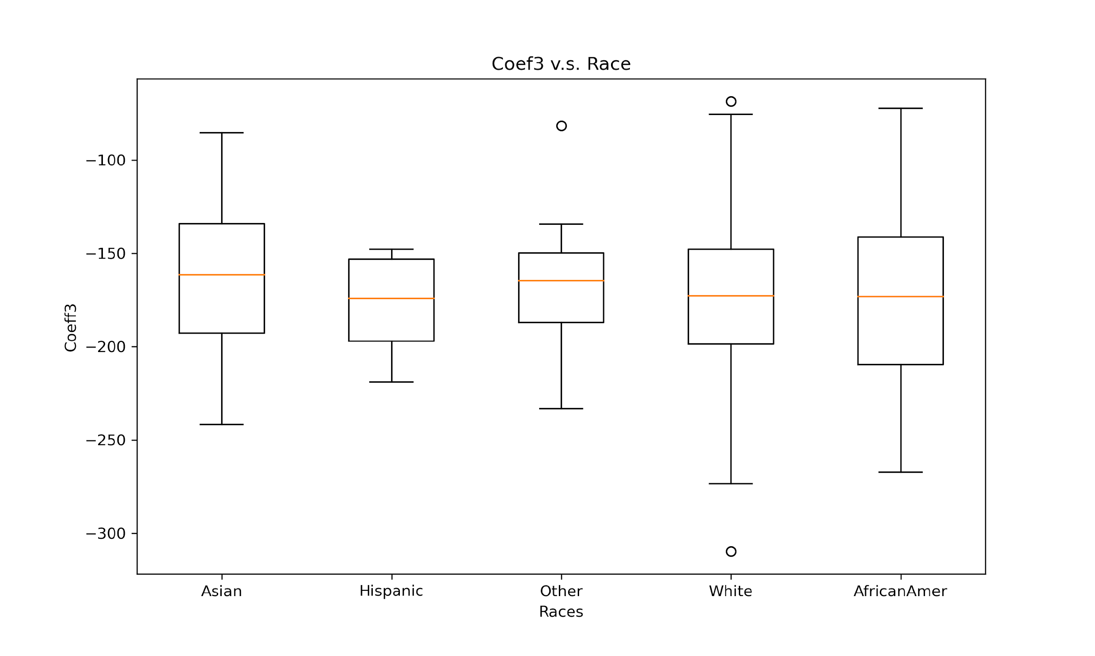
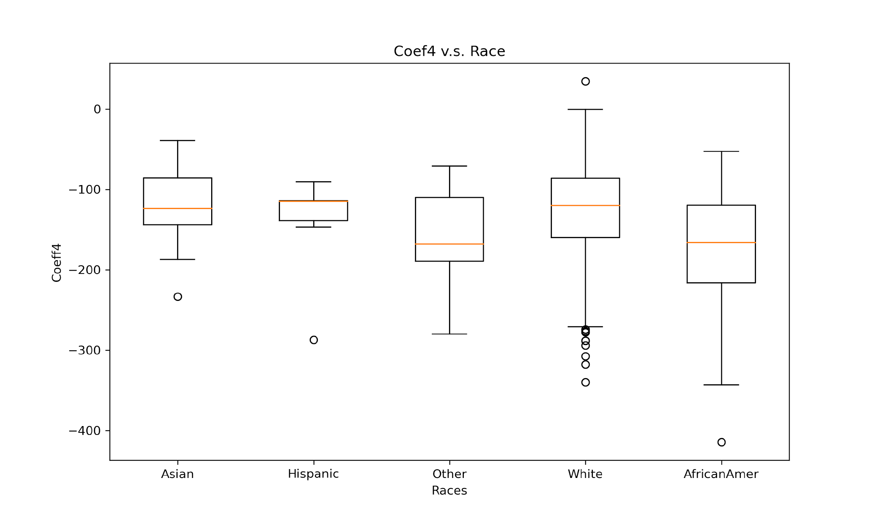
Key Question: Do body shapes vary based on factors such as ethnicity, height, or BMI?
Variations – Coefficients vs. Race

Slide 25
Key Question: Is it possible to predict curve shapes based on measurements such as maximum hip circumference and crotch depth?

Slide 26
Key Question: Is it possible to predict curve shapes based on measurements?
Strategy:
Use supervised learning to predict the 4 spline model coefficients based on features (i.e. max hip, depth, height) for each curve
Plot the predicted crotch curves based on the predicted coefficients
Train
Predict
Plot
Predicted Curves
Dataset
(features and coefficients)
Model
Predicted Coefficients

Slide 27
Key Question: Is it possible to predict curve shapes based on measurements?
Predicting Coefficients
Features
Coefficients
Race
Ridge Regression
R-Squared Values of Predicted Coefficients
Coef_1
Coefficient | Training Set for Back Curves | Testing Set for Back Curves | Training Set for Front Curves | Testing Set for Front Curves
coef1 | 0.24 | 0.05 | 0.58 | 0.38
coef2 | 0.41 | 0.17 | 0.4 | 0.22
coef3 | 0.52 | 0.31 | 0.63 | 0.33
coef4 | 0.43 | 0.34 | 0.41 | 0.33
BMI
Heights
Coef_2
Max. Hip Circum.
Coef_3
Ant./Poster. Length
Coef_4
Depth

Slide 28
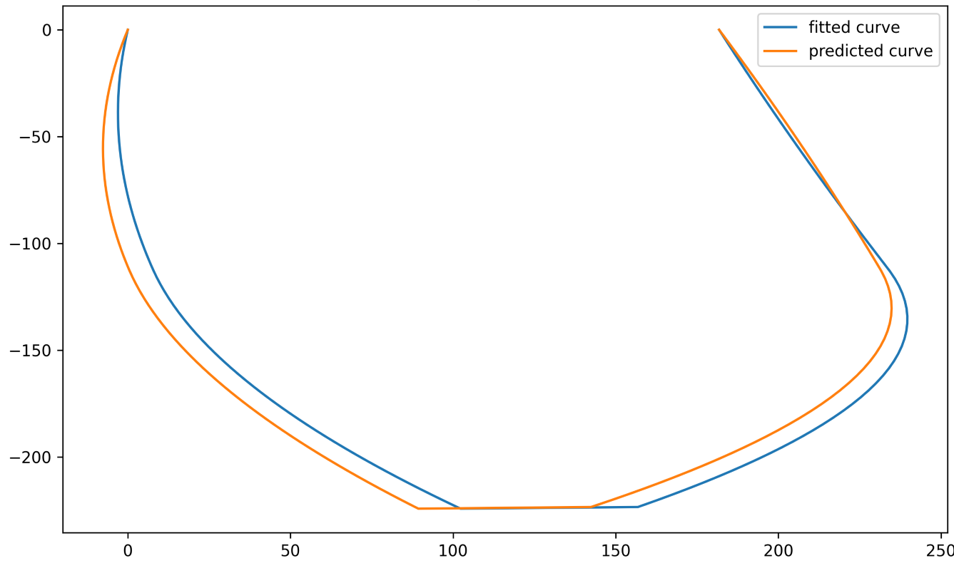
Key Question: Is it possible to predict curve shapes based on measurements?
Plotting Curves – Predicted Curves and Fitted Curves
Plot the front and back curves separately using predicted coefficients
Rescaled the coordinates of curves to match the measurements in our dataset
Concatenated the front and back curves using the anterior and posterior length
Predicted Curve and Fitted Curve
Median R-Squared Values of Predicted and Fitted Curves
Race | White | African American | Asian | Hispanic | Other
Median R-Squared | 0.993 | 0.981 | 0.966 | 0.293 | 0.8
Sample Size | 396 | 66 | 55 | 6 | 14

Slide 29
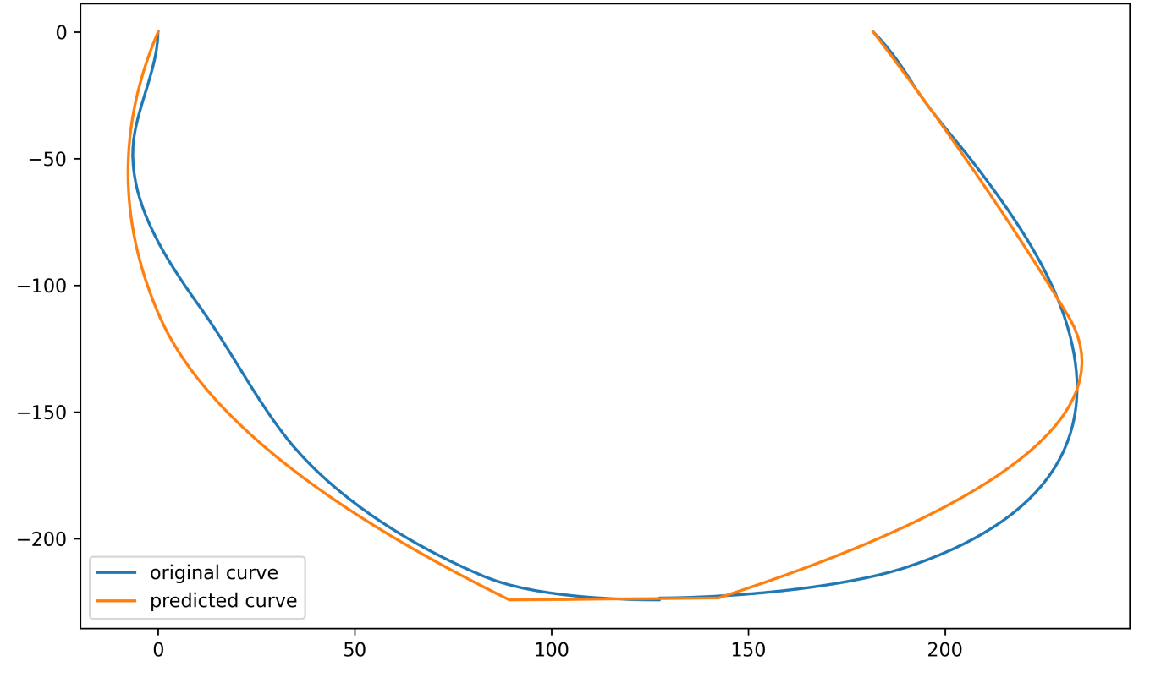
Key Question: Is it possible to predict curve shapes based on measurements?
Plotting Curves – Predicted Curves and Original Curves
The goal is to predict the original curves instead of the fitted curves
Directly compare the predicted curves with the original curves
Predicted Curve and Original Curve
Median R-Squared Values of Predicted and Original Curves
Race | White | African American | Asian | Hispanic | Other
Median R-Squared | 0.985 | 0.974 | 0.958 | 0.292 | 0.795
Sample Size | 396 | 66 | 55 | 6 | 14

Slide 30
Key Question: Is there any distinct pattern that differentiated the races?

Slide 31
PCA and K-Means
Focus on White, African American, and Asian groups
Polynomial curve fitting used for both front and back curves
Dataset merged using subject ID and columns standardized for K-means
PCA used to explore possible differences between race groups
Elbow method used to determine optimal number of K-means clusters
K = 3 obtained for both White vs. African American and White vs. Asian (distortion scores of 1929.158 and 1920.364, resp.)
No distinct pattern found to differentiate races in scatterplots
Cluster map created for numerical covariates to find relationships between races
Four front and back curve coefficients shared traits for White vs. African American groups
Findings similar for White vs. Asian groups
Clustering did not provide evidence that features are strong predictors of race

Slide 32
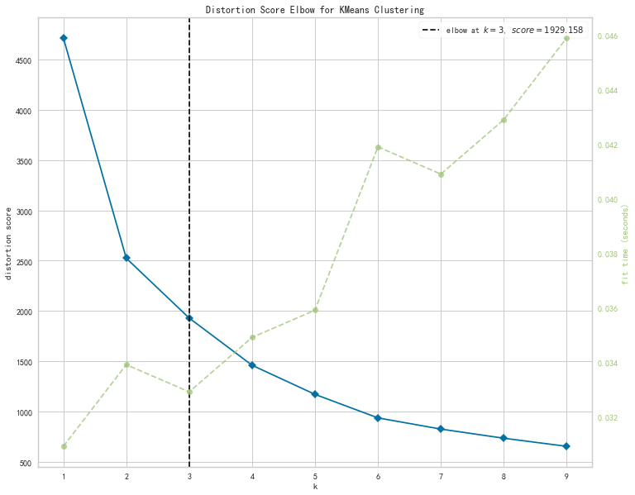
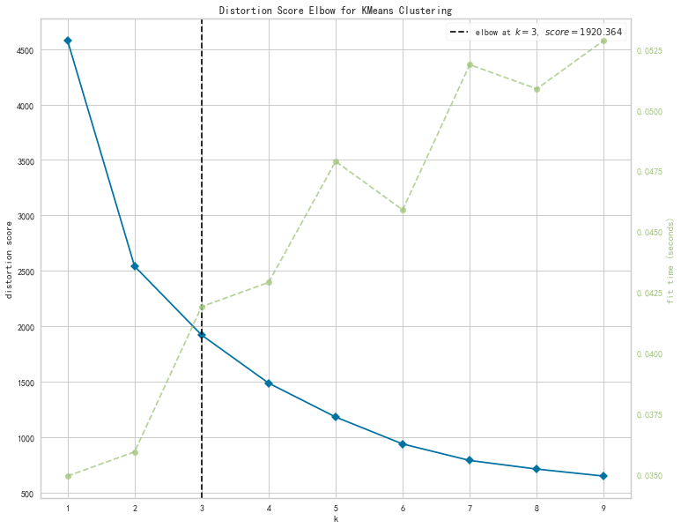
Elbow Method for K-Means
White vs. African American
White vs. Asian

Slide 33
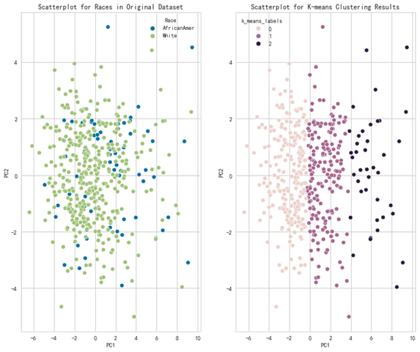
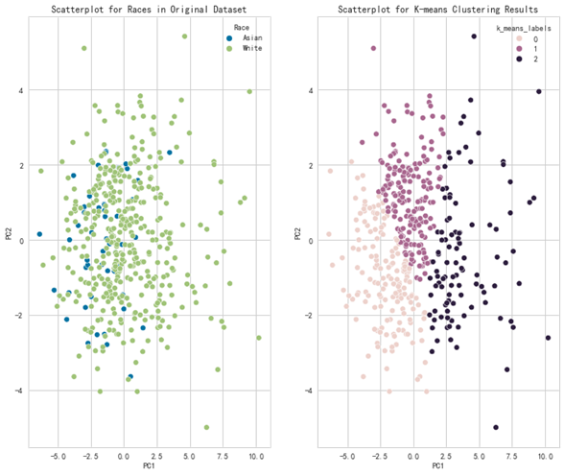
Scatterplots of K-mean clustering
K-mean scatterplot for Whites vs. African Americans
K-mean scatterplot for Whites vs. Asians
No distinct pattern that differentiates the races.

Slide 34
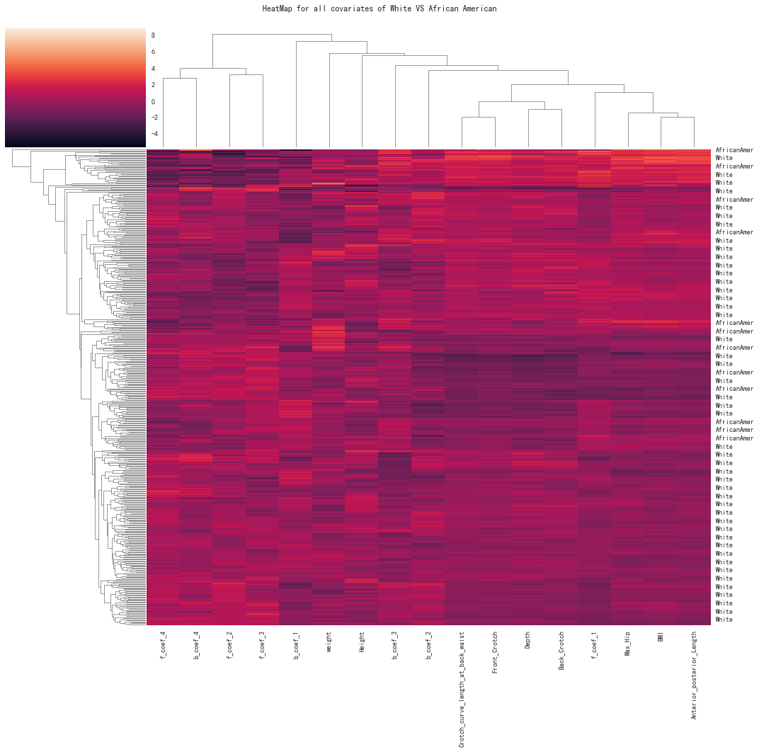
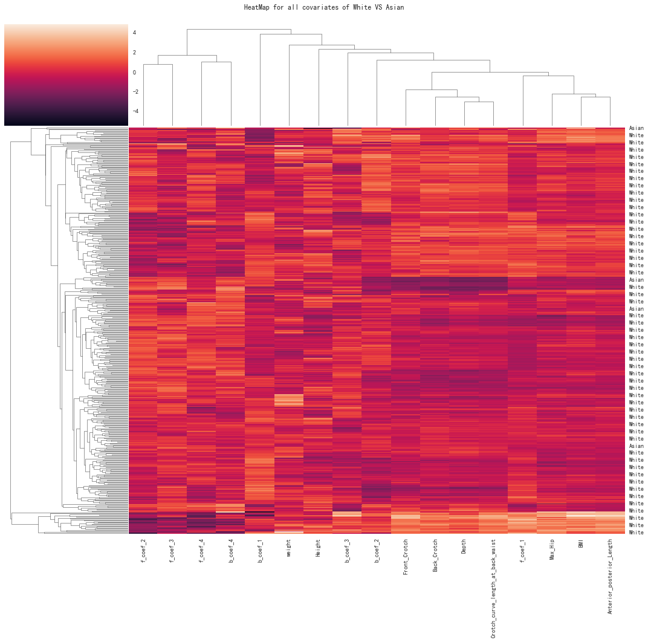
Heatmap for Whites vs. African Americans
Heatmap for Whites vs. Asians
Four of the front and back curve coefficients shared traits, as did the remaining eight features;
Overall, the clustering approach did not provide evidence that the features are strong predictors of race.
Footnotes: f_coef stands for the front curve coefficient and b_coef stands for the back curve coefficient

Slide 35
Key Question: Is it possible to predict the race of the subject based on body measurements and front and back curve coefficient?

Slide 36
Key Question: Is it possible to predict the race of the subject based on his/her body measurements and front and back curve coefficients?
Results from Logistic Regression
 | White vs. African Americans |  | Whites vs. Asians
 | Balanced training set
 | Balanced test set | Imbalanced test set | Balanced test set | Imbalanced test set
Accuracy | 0.78 | 0.73 | 0.68 | 0.62
Precision | 0.77 | 0.93 | 0.63 | 0.88
Recall | 0.76 | 0.73 | 0.80 | 0.65
AUC | 0.83 | 0.80 | 0.81 | 0.52
Body measurements and especially the front and back curve coefficients have some predictive power for race;
Data Imbalance problem really matters the accuracy in Logistic Regression setting.

Slide 37
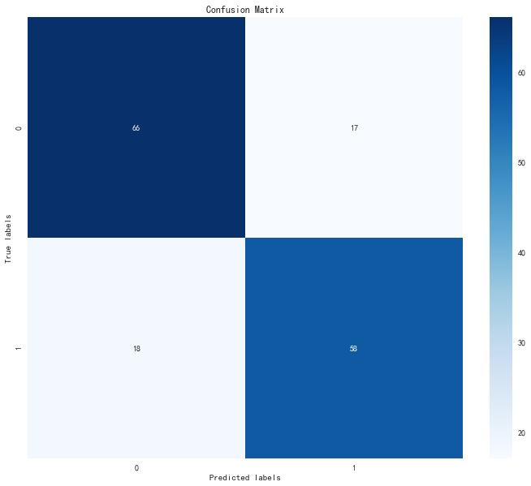
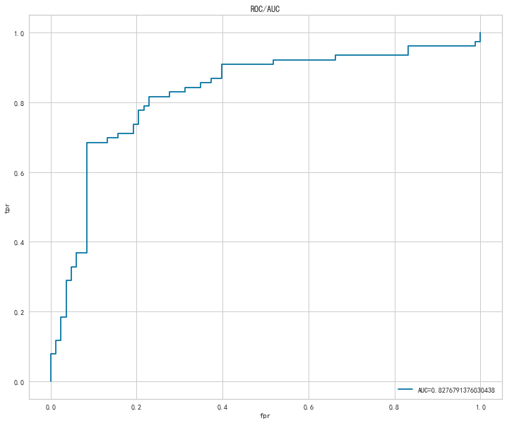
Logistic Regression (African American vs. White)
Confusion matrix for the logistic regression
ROC/AUC curve

Slide 38
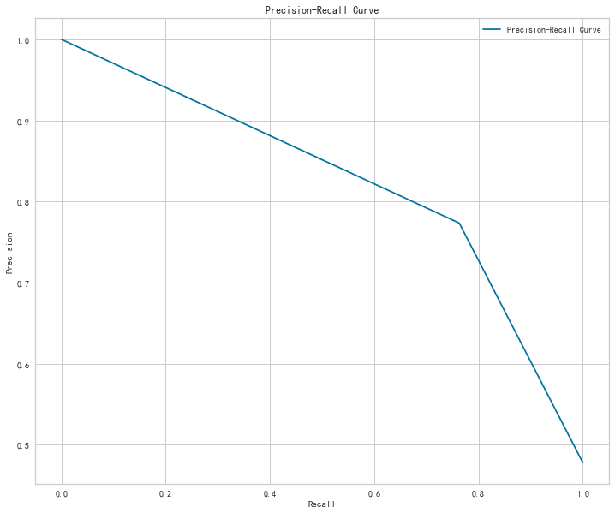
Precision Recall Curve for logistic regression with African Americans vs. Whites

Slide 39
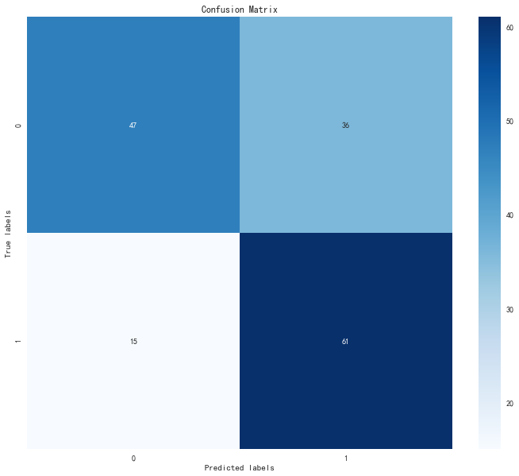
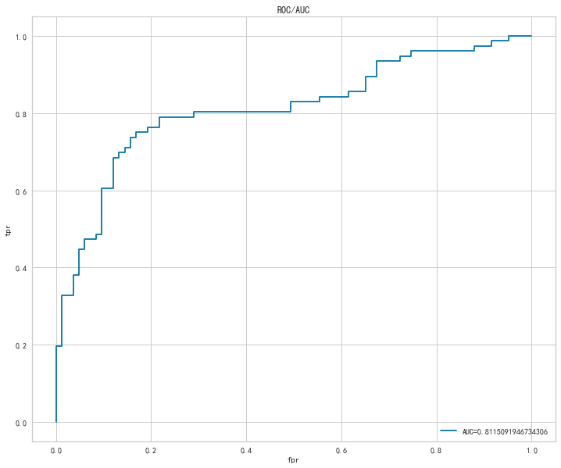
Logistic Regression (Asian vs. White)
Confusion matrix for the logistic regression
ROC/AUC curve

Slide 40
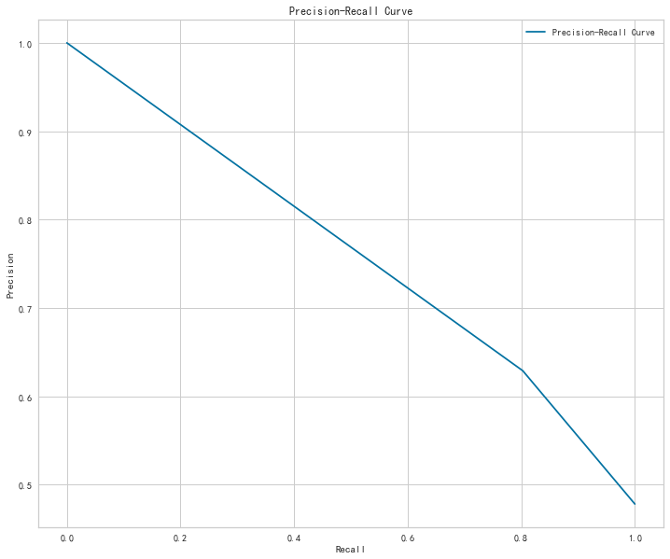
Precision Recall Curve for the Logistic Regression with African Americans vs. Whites

Slide 41
Results from Random Forest
 | Whites VS. African Americans |  | Whites VS. Asians
 | Balanced training set
 | Balanced test set | Imbalanced test set | Balanced test set | Imbalanced test set
n_estimators | 100 | 100 | 1000 | 500
max_features | ‘sqrt’ | ‘sqrt’ | ‘auto’ | ‘sqrt’
max_depth | 50 | 30 | 50 | 50
min_samples_split | 2 | 2 | 2 | 2
min_samples_leaf | 1 | 2 | 1 | 1
Accuracy | 0.88 | 0.81 | 0.92 | 0.86
Body measurements and front and back curve coefficients have some predictive power for race;
Data Imbalance problem does not affect the accuracy much in Random Forest setting;
Improvement in accuracy implies that there exists interaction between covariates.
Footnotes: N_estimators stands for the total number of trees; Max_features stands for the maximum number of features selected at every split; Max_depth stands for the maximum depth of each individual tree; Min_samples_split stands for the minimum number of samples required to split an internal node; Min_samples_leaf stands for the minimum number of samples in each leaf

Slide 42
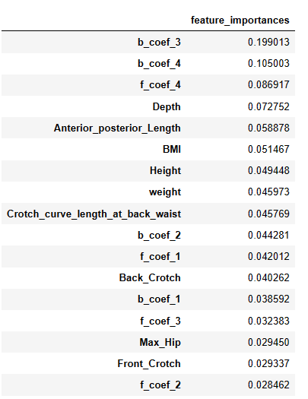
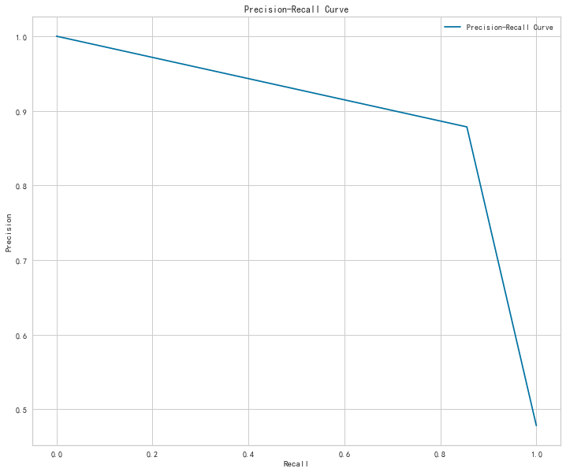
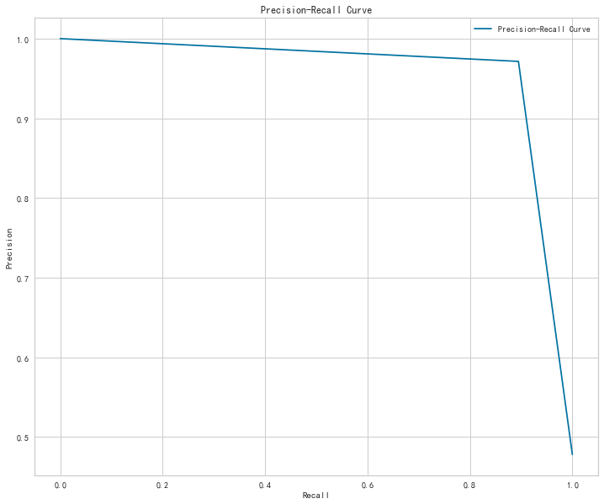
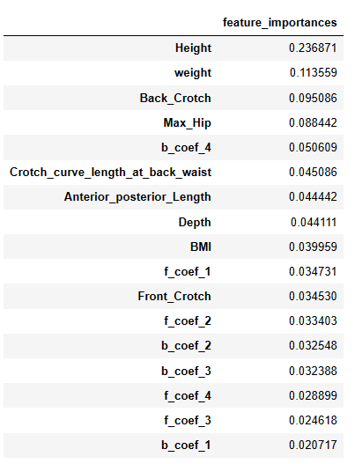
African American VS White
Asian VS White
Precision Recall Curve for the Random Forest
Feature importance for the Random Forest

Slide 43
Results from XG Boost
​​​ | ​White VS African American​ |  | ​White VS Asian​
 | ​Balanced train set​
 | Balanced test set​ | Imbalanced test set​ | Balanced test set​ | ​Imbalanced test set​
​n_estimators ​ | ​1000​ | 300​ | ​1000​ | 500​
​max_depth​ | ​10​ | ​4​ | ​4​ | 10​
learning_rate​ | ​0.1​ | ​0.1​ | ​0.01​ | ​0.1​
​Accuracy​ | ​0.88​ | ​0.81​ | ​0.92​ | ​0.85​
Body measurements and front and back curve coefficients have some predictive power for race;
Data Imbalance problem does not affect the accuracy much in XGBoost setting;
Improvement in accuracy implies that there exists interaction between covariates.
Footnotes: N_estimators stands for the total number of trees; Max_depth stands for the maximum depth of each individual tree; Learning_rate stands for the step size of each gradient descent update

Slide 44
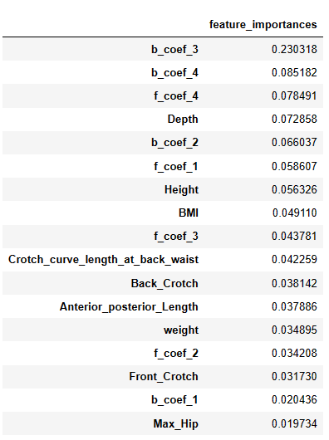
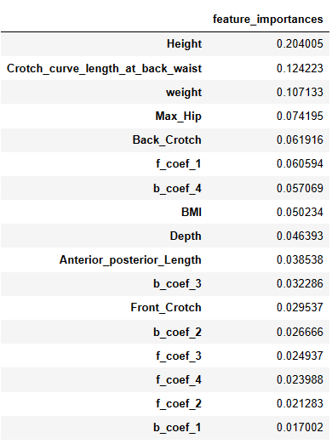
African American VS White
Asian VS White
Precision Recall Curve for the XGBoost
Feature importance for the XGBoost

Slide 45
Conclusion:
The body shapes vary based on the races and BMI
There is no distinct pattern that differentiates the races
Body measurements and both front and back curve coefficients can predict race well
There are interactions between covariates
Factors such as max hip, BMI play important roles in predicting the body shapes

Slide 46
Limitations
Sample size for different racial cohorts are uneven, such that curve predictions for some races are more reliable than others
Other covariates not present in the data, such as age and body fat ratio, may have a stronger relationship with the shape of the curves

Slide 47
Future improvements
Research on how each coefficient impact the body shapes
Remove the none-convexity of the curve
Use neural networks to predict coefficients or even the coefficients directly
Increase the size of the dataset to increase the accuracy

Slide 48
References
Song, H. K., & Ashdown, S. P. (2011). Categorization of lower body shapes for adult females based on multiple view analysis. Textile Research Journal, 81(9), 914–931.
Su, J., Ke, Y., Kuang, C., Gu, B., & Xu, B. (2019). Converting lower-body features from three-dimensional body images into rules for individualized pant patterns. Textile Research Journal, 89(11), 2199–2208.
Xia, Y., Shao, J., Zhang, B., Jin, S., Li, Y., & Gu, B. (2022). Individualized generation of young women’s crotch curve based on body images. International Journal of Industrial Ergonomics, 90, 103296.

Slide 49
Thank you!

